Slide 1
Students Services Portal
N.Kranthi Kumar
T.Venkata Bharath
D.Sudhigna Yadav

Slide 2
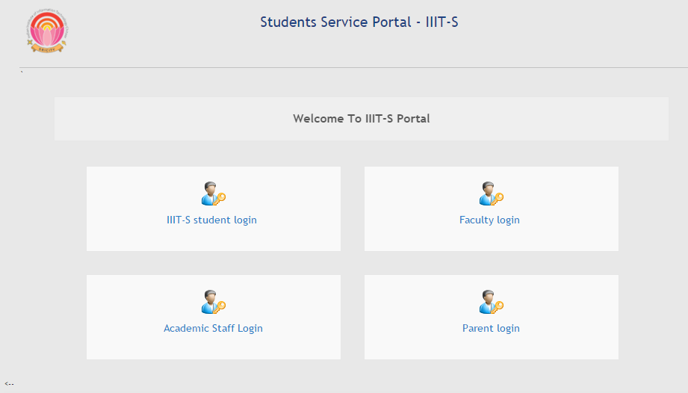
Home page of the Portal

Slide 3
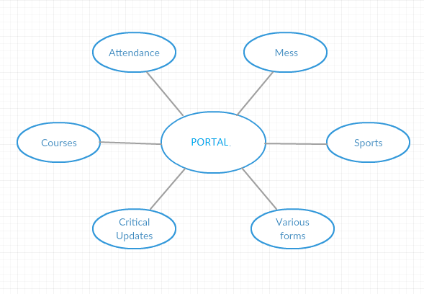
What services does the portal provide?

Slide 4
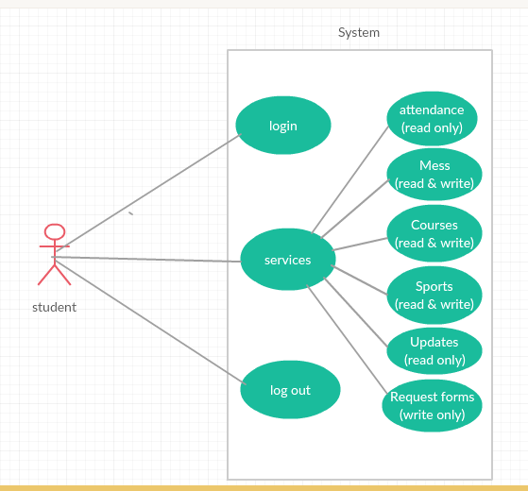
Student

Slide 5
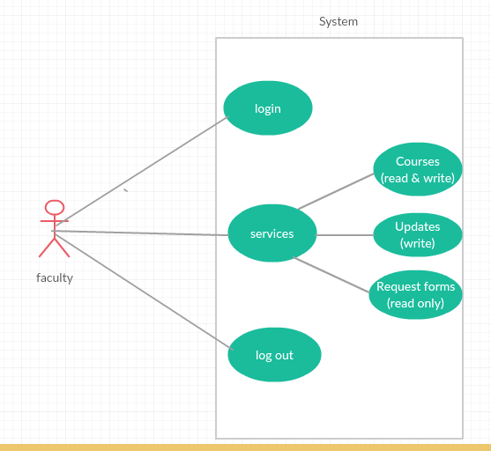
Faculty

Slide 6
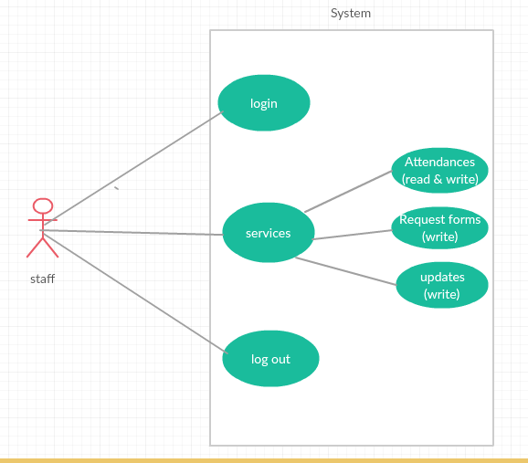
Staff

Slide 7
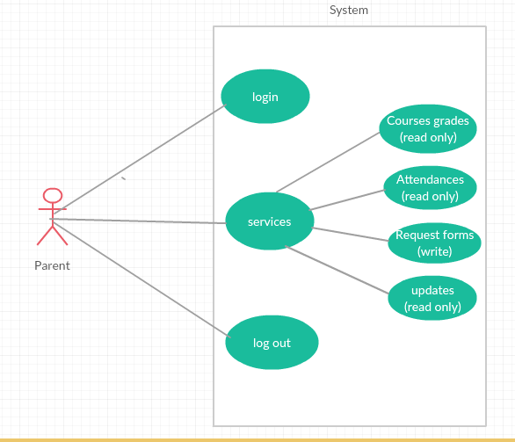
Parent

Slide 8
Web Technologies
HTML
CSS
JAVASCRIPT
BOOTSTRAP
PHP(Server-Side Script)
MYSQL

Slide 9
Thank You

